Slide 1
Level 5 & 6 Information Evening
Term 1, 2024
Grade 5 - Linda Bett, Chris Young, Ilana Tusia
Grade 6 - Caroline Eaves, Simon Judkins
Educational Support - Chrissie Sandford-Ricci, Fiona Schwass, Andy Pullar, Jo Hewett

Slide 2
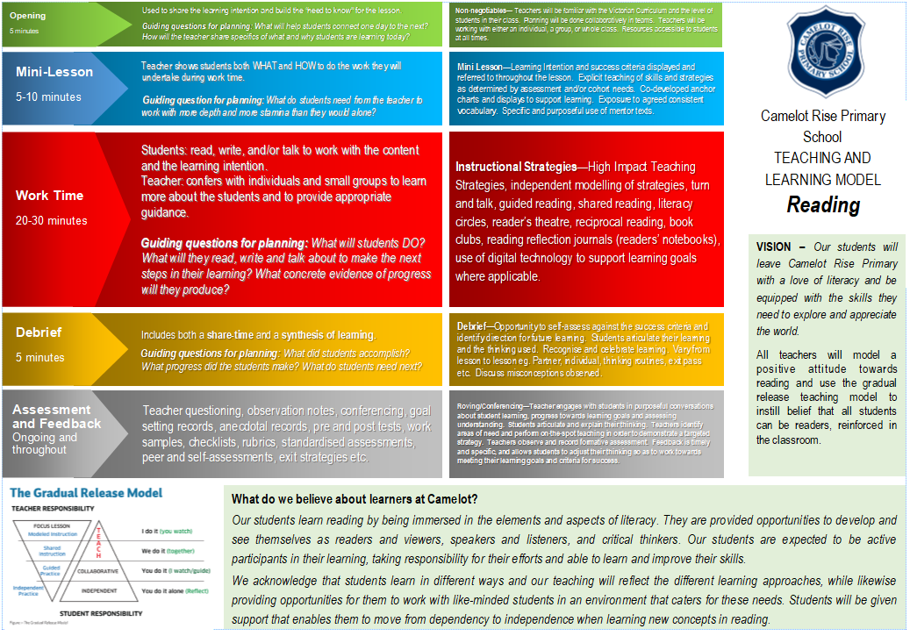
Notes:
Linda

Slide 3
Reading and viewing
Students’ reading will improve through opportunities to regularly read books of their choice.
The teacher will regularly meet with different students and focus on core reading comprehension strategies. This will be done in either small groups or individually.
A part of reading in Level 5/6 is being able to work in small groups focusing on text analysis, comprehension and independent reading.
Students are taught to monitor and track their thinking in different ways. They will be encouraged to use their Reader’s Notebooks to capture their responses.
Notes:
Linda

Slide 4
Notes:
Linda

Slide 5
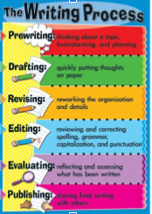
How we teach writing All lessons follow the CRPS Instructional Model and Gradual Release of Responsibility
Methods of instruction:
Modelled writing
Shared writing
Conferencing
Purpose for writing:
to entertain
to persuade
to inform/explain
Writer’s Notebooks
Writing seeds and ideas
The writing process:
Pre-writing
Drafting
Revising
Editing
(Evaluate)
Publishing
Handwriting Spelling/Word study Grammar
Notes:
Linda

Slide 6
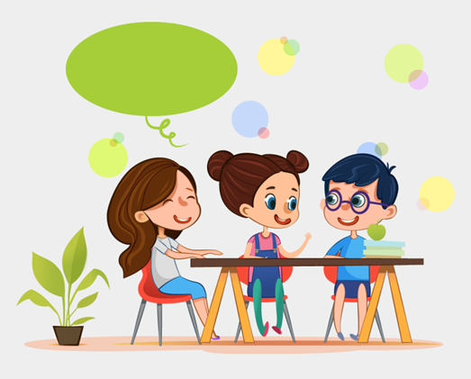
Speaking & Listening
Opportunities:
Conferencing
Whole class/small group discussions
Circle time
Small collaborative group work
Formal and informal presentations
Pair discussions
Notes:
Linda

Slide 7
Mathematics
Across Level 5/6
Use a consistent lesson structure - instructional model
Essential Assessments – pre/post testing
Maths classes change throughout the year depending on each student’s point of need across the different areas of mathematics. This means that the concepts being taught match each student’s needs and are grouped with other like-minded students
Students work in a variety of ways - aiming to build upon all 4 areas of mathematical thinking: understanding, fluency, reasoning and problem solving
Use a variety of hands on materials
Mathletics
Notes:
Simon

Slide 8
Differentiation Example
This is a Year 5/6 example:
Learning Focus - Number and Place Value
Group 1 - Working with numbers beyond one hundred thousands
Group 2 - Working with numbers with decimals
Group 3 - Factors, Multiplies, Squares, Cubes
Group 4 - Integers, Index notation to express numbers
Fluid groups based on individual assessments.
Notes:
Simon

Slide 9
Digital Devices
What DT with devices looks like at Level 5/6:
Safe computer usage – including Cyber Safety and how to use different types of technology safely
All computer usage at school is supervised and structured to enhance student learning
Learning to use a range of devices, including netbooks and iPads
Learning how to create, store, save and retrieve files correctly in a variety of spaces, including Office365 and MS Teams
Using Microsoft Office programs (e.g. Word, PowerPoint, Publisher and Excel) to present ideas and learning
Developing research skill with the use of technology
A note about phones and watches
Notes:
Simon

Slide 10
Digital Technologies
What DT looks like at Level 3/4:
Code.org – blocky code, extending into python where necessary
Spheros and drones
Green screen and image editing
Design and technology – engineering and mathematics concepts
Cybersafety
Notes:
Simon

Slide 11
Seesaw
This is our student to parent communication portal.
Students share snapshots of their work throughout the year, covering a variety of subjects and classes.
If you aren’t already connected to Seesaw, you will get an email shortly asking you to join seesaw. Once you do this, you will be able to see any work your child has added. You will be able to leave a comment for them, if you wish.
Once signed up, you will receive an email whenever something new gets posted.
You can expect 4-5 pieces of work per term.
Notes:
Simon

Slide 12
Notes:
Caroline

Slide 13
CRPS Whole School Wellbeing Program
Buddies, Lunchtime activities, Buddy Bench corner, Wellbeing captains, SWAT.
Schoolwide wellbeing programs:
Respectful relationships - government initiative
Resilience Project
Schoolwide positive behaviours
Restorative Practice
Also factored in are:
Class meetings
Behaviour matrix
School values - Respect, Responsibility, Resilience
Class and schoolwide rewards
Notes:
Caroline

Slide 14
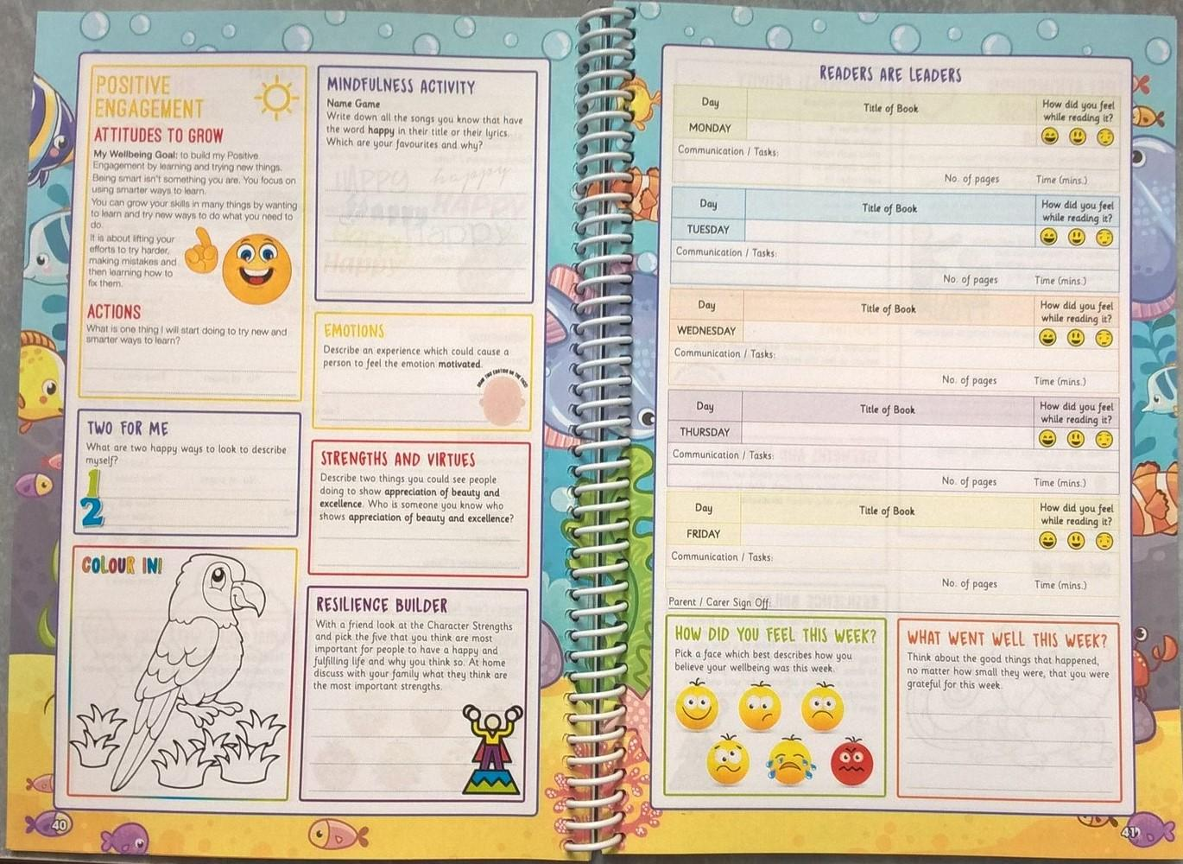
Homework
The Homework expectations for students in Levels 5 and 6
Homework will be set on Monday and due on Friday. On Friday morning, diaries will be reviewed in class for each student’s completion of the following:
Reading - 30 mins per week night recorded in Diary
Maths - weekly tasks
Well being - weekly activities set in Diary (optional)
Notes:
Caroline

Slide 15
Specialist Programs
French Rosemary Thom
Physical Education and Sport Cameron Stillman
Visual Arts Debra Hong
Performing Arts Debra Hong
STEM - Lorna Vinar
Notes:
Ilana

Slide 16
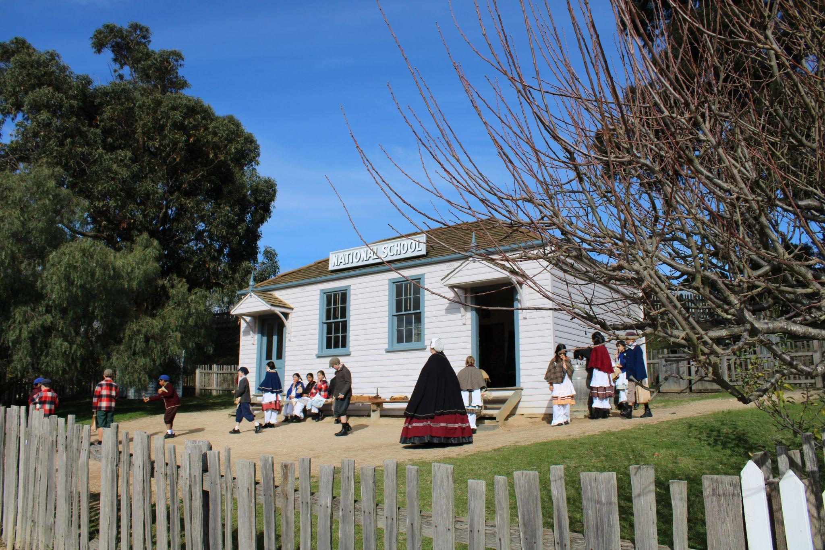
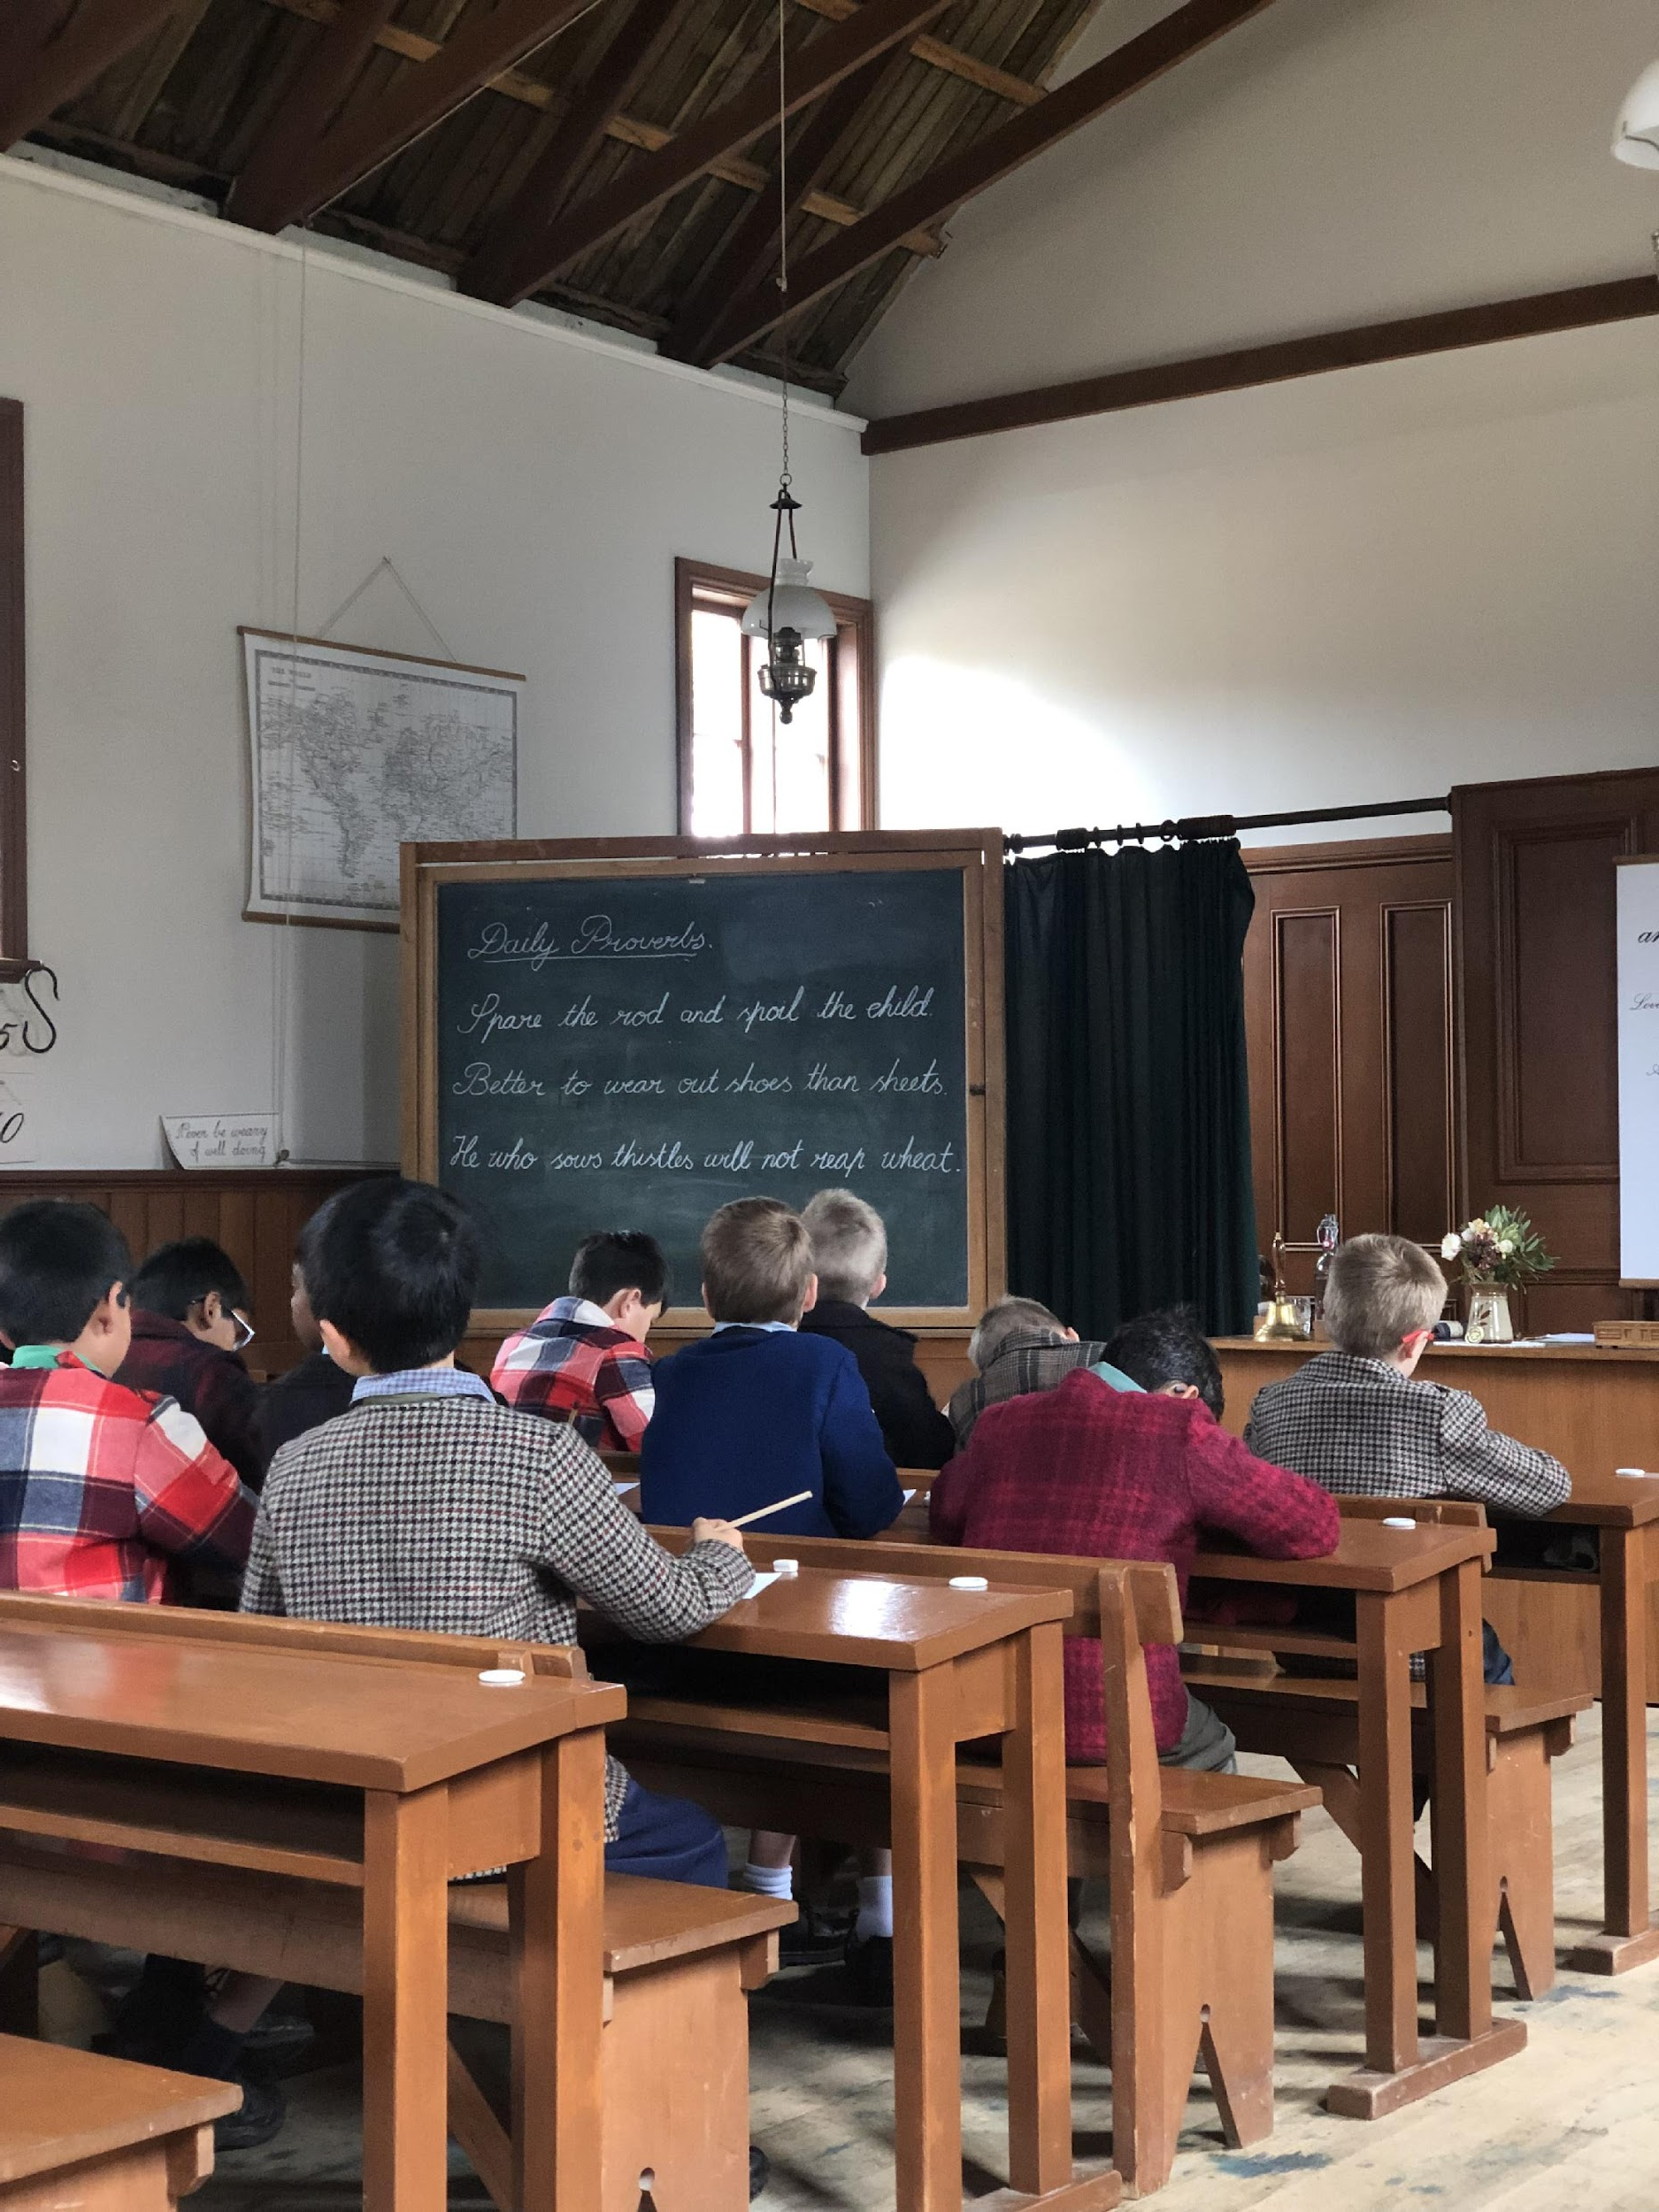
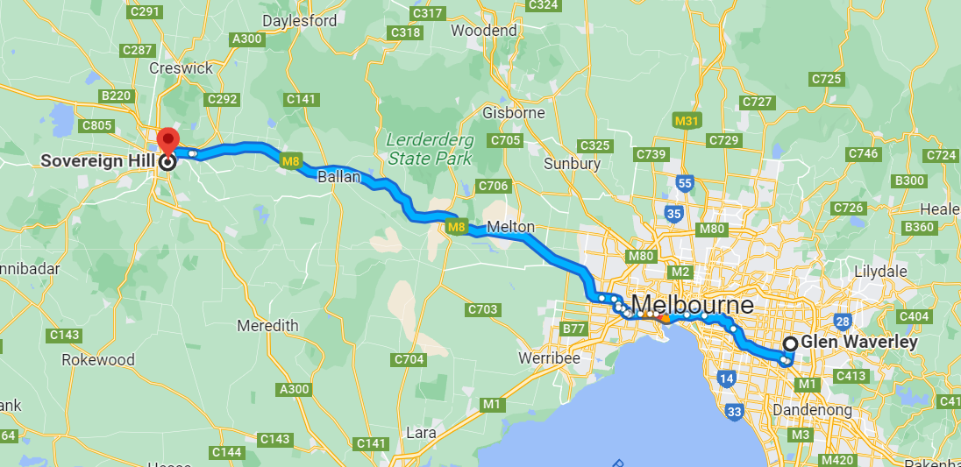
Year 5 Camp
Camps
Year 5 Sovereign Hill Camp: 22nd - 24th April (Term 2)
Notes:
Ilana

Slide 17
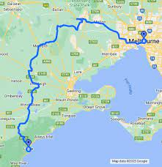
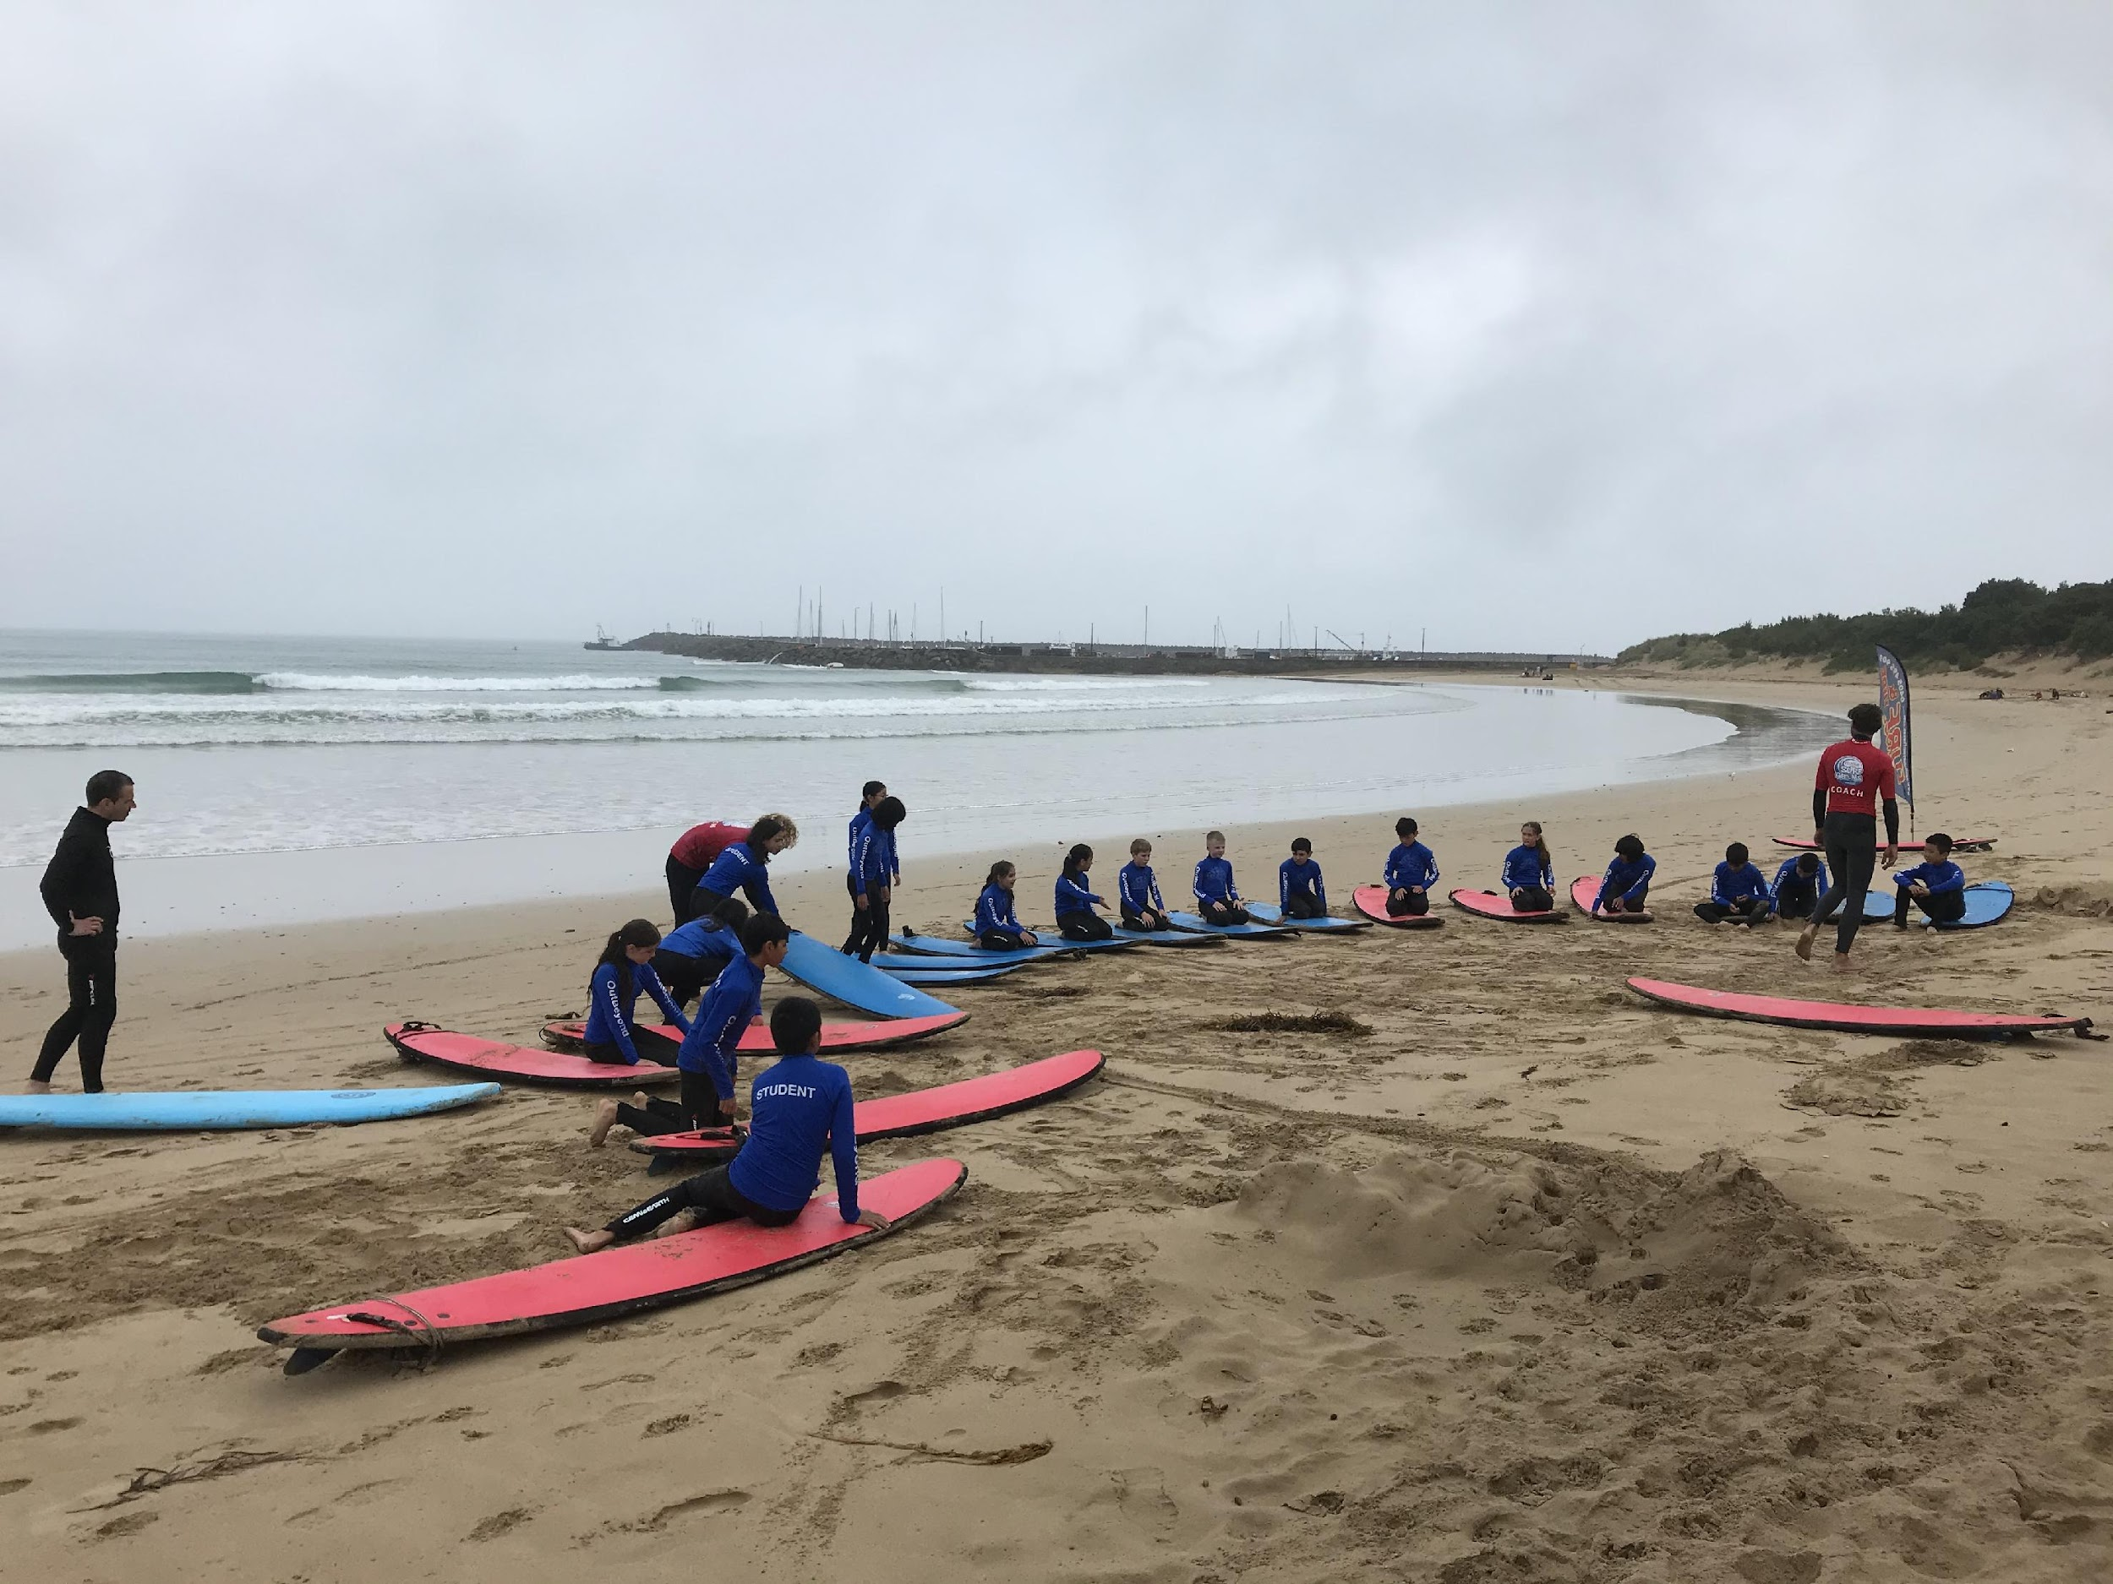
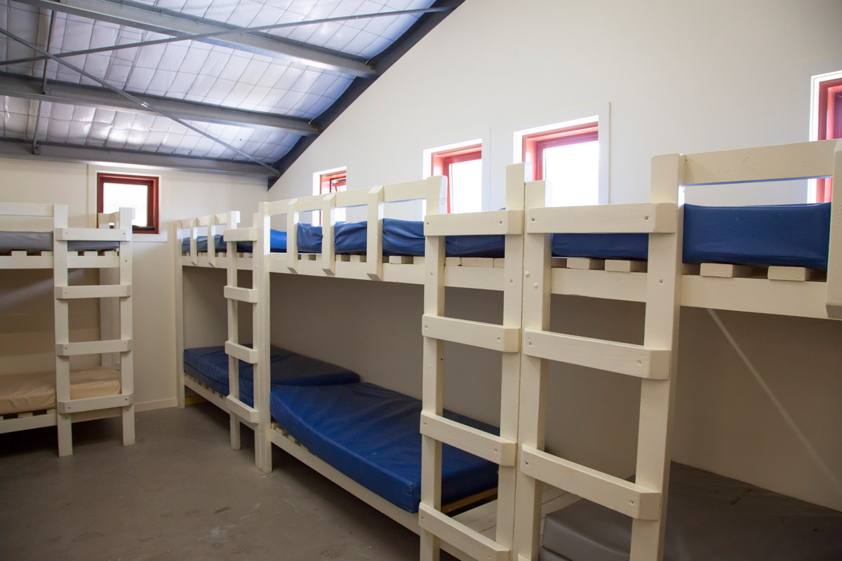
Year 6 Camp
Camps
Year 6 Lorne Surf Camp: 21st - 25th October (Term 4)
Notes:
Ilana

Slide 18
What?
During 2015 CRPS is implementing a staged release of our new school management software, Compass School Manager.
Throughout the coming year, we plan to release other features which will allow you to:
Access your child's semester reports
Access your child's progress reports (year 2)
Download, print and approve upcoming excursion/incursion forms
Pay school fees, charges and contributions online
Update your registered email and mobile number
Access information regarding upcoming events and news and lots more
Email your child’s teacher
Compass
We use Compass as a means of communication between classroom teachers and parents.
If you would like any further information about Compass, see the Office.
Please check Compass regularly for upcoming events and to log absences.
The School Newsletter is available from the school website and via the notification on Compass.
Notes:
Ilana

Slide 19
Parent Representatives
Helps foster communication within the school community
Class or Year Level Representative (volunteer) to compile a family contact list (opt-in participation), organise family activities out of school hours, providing reminders to parents of any upcoming events and promoting communications between school and parents.
Working with Children Check (receipt accepted)
Notes:
Ilana

Slide 20
Encouraging your child to be independent.
Develop their organisation skills by using a diary.
In preparation for camp, pack their own bag and be responsible for what items are included in their bag.
Mobile phones/smart watches that can be used as phones must be checked into the safe at 8:50am and they can be collected at the end of the day.
Get to school on time at 8.45. The school grounds are unsupervised before 8:45 am and after 3.45 pm.
Notes:
Ilana

Slide 21
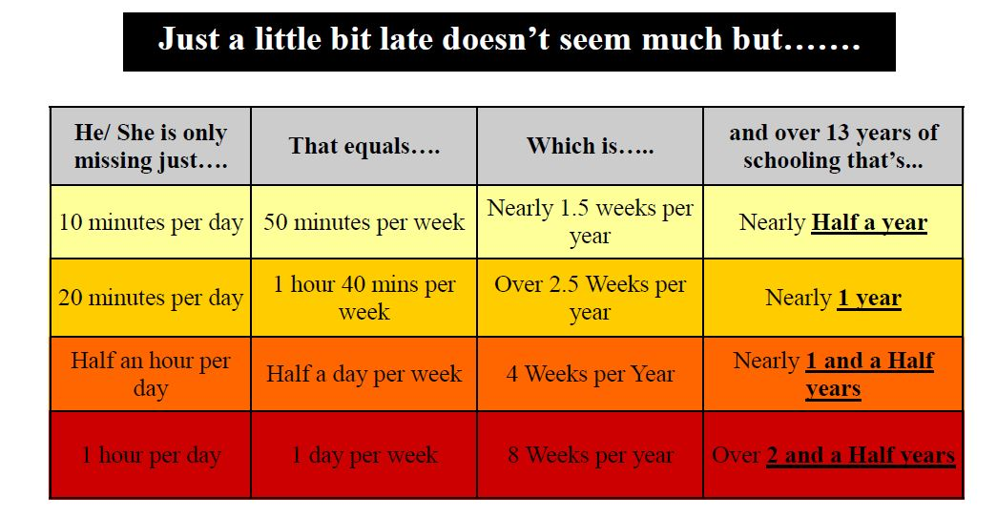
Attendance is important for your child's learning
Notes:
Ilana

Slide 22
Thank you
Question & Answer time

