Slide 1
Level 1/2 Information Evening Term 1, 2024
Tennille Giannopoulos & Karen Watts 1GW
Aggie Kurzak-Reeves 1KR
Le-Buu Ly 1L
Stephanie Johnson (Team leader) & Peta Rose 2JR
Lauren Gabriele 2G
Julie Shepherd 2S
Andy Puller, Chrissie Sandford-Ricci, Jo Hewett and Fiona Schwass (ES staff)
Notes:
Aggie - Welcome Hello
Run down of the evening.

Slide 2
Quality Beginnings
In our first week of school we set up our learning community in our classroom. This involved:
Classroom expectations
Morning and afternoon routines
Understanding how we learn
Learning about each other
Developing friendships
Notes:
Peta

Slide 3
What?
During 2015 CRPS is implementing a staged release of our new school management software, Compass School Manager.
Throughout the coming year, we plan to release other features which will allow you to:
Access your child's semester reports
Access your child's progress reports (year 2)
Download, print and approve upcoming excursion/incursion forms
Pay school fees, charges and contributions online
Update your registered email and mobile number
Access information regarding upcoming events and news and lots more
Email your child’s teacher
Compass
We use Compass as a means of communication between classroom teachers and parents.
If you would like any further information about Compass, see the Office.
Please check Compass regularly for
upcoming events and to log absences
School Newsletter - available from school website and notification on Compass.
Notes:
Peta

Slide 4
CURRICULUM
How we teach Reading
Vision: At CRPS we want students to develop a love of literacy and to be equipped with the skills they need to explore and appreciate their world. This is one of the most important parts of your child's learning in lower primary. We really help foster their love of learning and believe that the most important thing your child can do at home with their parents is to read, read and read some more!
At school we focus on:
5 hours of reading lessons per week
Explicit instruction of reading skills and strategies as a whole class, small group or individually
Examples of Methods of Instruction
Modelled reading
Shared reading
Teacher focus groups (eg. Guided reading)
Conferencing – individual goal setting
Independent reading
Buddy reading
Notes:
Peta

Slide 5
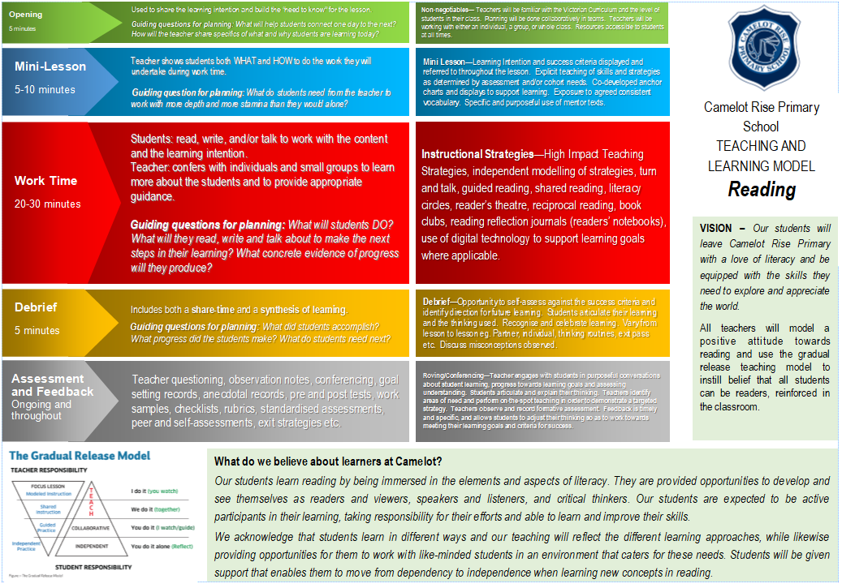
Notes:
Peta

Slide 6
How we teach Writing
Ralph Fletcher: “We need to set up a community of writers who write from their heart and their head.”
•In the classroom:
•They will use a Writer’s Notebook to help with writing ideas
•We will use a Writing process: planning, drafting, revising and sometimes publishing
•Some texts may be worked on for several sessions
•Writing conventions will be taught in context
•We will examine many different writing forms
Notes:
Karen

Slide 7
Different writing elements 5 hours of writing lessons per week - minimum
Methods of instruction:
Modelled writing
Shared writing
Conferencing
Purposes for writing:
to entertain
to persuade
to inform/explain
Language Experience
Oral language - EAL (language experience)
0 Writer’s Notebook
The writing process:
Brainstorm/Plan
Draft
Revise
Edit
Publish
Notes:
Karen

Slide 8
How we teach Spelling
We will teach students spelling throughout the week.
Spelling will be differentiated and taught to students to support them at their point of need.
Notes:
Lauren

Slide 9
Speaking & Listening
Classroom and Specialist opportunities:
Shared reading (whole class)
Buddy Reading
Conferencing
Whole class/small group discussion
Circle time
Class Meetings
Small group work
Formal upfront presentations
Pair discussion/Talking Buddies
Take home pet
Notes:
Lauren

Slide 10
Maths
Across Level 1/2
5 hours of maths lessons per week
We follow our Teaching and Learning Model when teaching Maths
Maths concepts are taught at the students’ point of need
All students are extended according to assessments
Students work in a hands-on way with a variety of materials
Students to see links between different areas of the curriculum
Essential Assessments – Pre/Post testing
We used this data to form teaching focus groups and to plan for Teaching and Learning in PLTs
Mathletics
Notes:
Aggie - Make sure to discuss PONT and how the students may move to work with different teachers based on their needs.

Slide 11
Inquiry
Term 1 – Healthy minds and healthy bodies: Why is it important to have a healthy body and mind?
Students will explore these key concepts:
Our bodies and minds need: rest, exercise, nutrition, mindfulness and hygiene.
The choices we make affect our bodies
Individuals and our community help us to maintain our health
Media influences the choices we make
Our lives need balance.
Notes:
Aggie

Slide 12
Digital Technologies
What DT looks like at Level 1 and 2
Learning to use a range of devices, including netbooks and tablet technologies;
Safe computer usage – including Cyber Safety and how to use different types of technology safely;
Learning how to create files, store and save files, retrieve files correctly;
Using technology to present thinking processes – making graphic organisers (e.g.. mind-maps);
Using Microsoft Office programs (e.g.. Word, PowerPoint, Publisher and Excel) to present ideas and learning).
All computer usage at school is supervised and structured to enhance student learning;
Notes:
Lauren

Slide 13
Seesaw
Why?
*Increased communication between home and school
*To provide more authentic examples of student achievement and progress
*To develop DT skills
How and When?
*Approximately 3 pieces per term from classroom teacher, 1 each from specialists over the year
*Families should already be connected - new students who aren’t connected yet, please email your class teacher.
Notes:
Le-Buu

Slide 14
Discovery
‘Play gives children a chance to practise what they are learning’- Fred Rogers
All level 1/2 classes will have at least one session of focused discovery learning weekly
Lessons will allow students to develop social and emotional regulatory skills
Teachers will take assessment notes on personal and social capabilities demonstrated through lessons
Experiences will be open ended (eg. Lego) or some planned to purposely tie in with curriculum focus (eg. family craft activity to link in with Inquiry).
Students can work across grades
Notes:
Lauren

Slide 15
CRPS Whole School Wellbeing Program
School values – Respect, Resilience, Responsibility
Wellbeing program within the classroom
– managing our emotions
– relationships
– how to make and keep friends
– social skills for the playground
– regular circle times
- buddies for Year 1s
School Wide Positive Behaviours - the school this year and will provide a framework for ALL students and teachers to work positively with expected behaviours
Resilience, Rights, and Respectful Relationships
Resilience Project
Buddy bench and peer mediators
Notes:
Karen

Slide 16
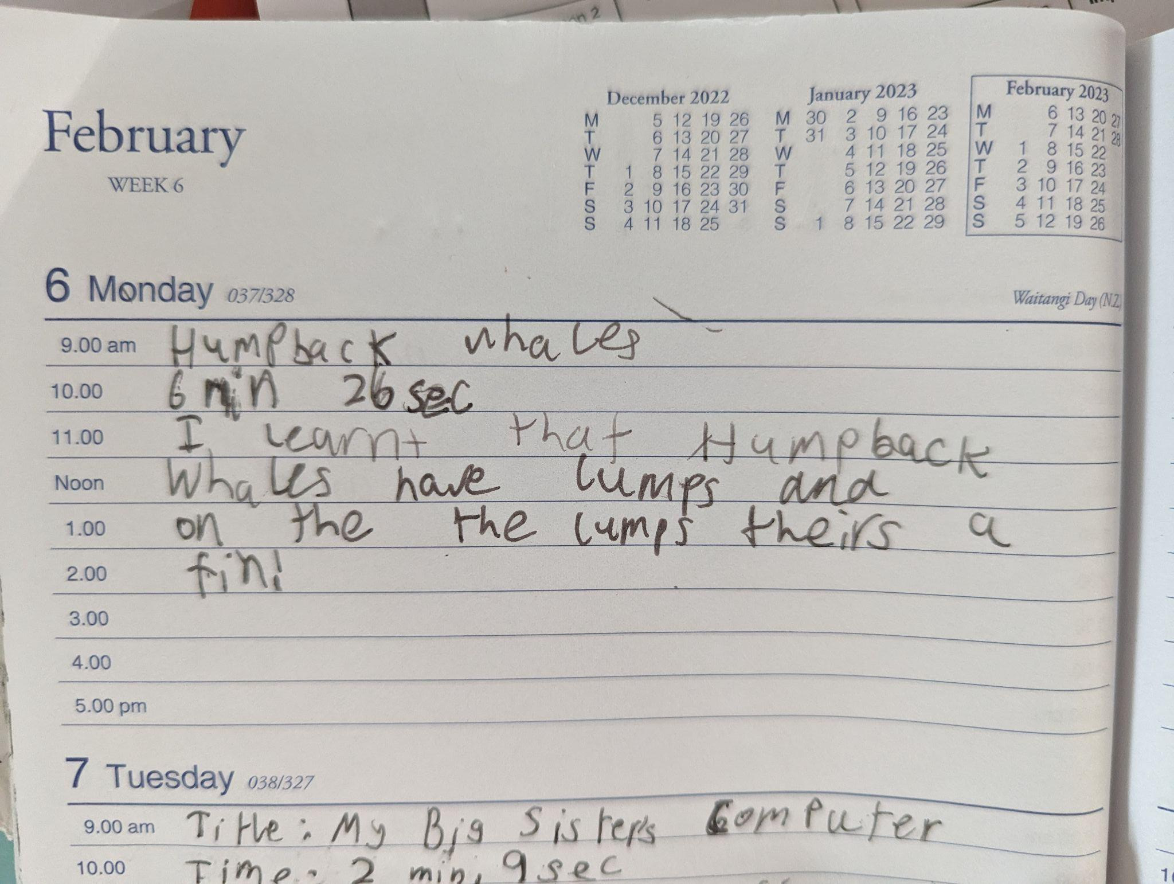
Homework
The Homework expectations for students in Levels 1 and 2 are:
Reading each night (recorded in Reading Log/Diary)
Participation in the Talk, Listen, Learn program
Notes:
Lauren

Slide 17
Specialist Programs
French
Rosemary Thom
Performing Arts
Deb Hong
Physical Education
Cameron Stillman
Visual Arts
Sharyn Newstead
STEM
Lorna Vinar
Notes:
Specialist Rep

Slide 18
Specialists
PERFORMING ART with Ms Debra Hong
PA encompasses Music, Dance and Drama. The students perform, create and respond as performers and audience members.
In Music they engage in listening and singing, play games and body percussion, and identify and use an assortment of tuned and untuned percussion instruments. They look at elements such as: beat, rhythm, pitch, dynamics, tempo and melody, and use simple musical terms, informal notation and rhythm syllables. In Drama students use impromptu acting and improvisation to tell a story, and in Dance they learn about space, movement and form in basic routines. Notable events include the Soiree, Christmas Concert and a Whole School Production.
VISUAL ARTS with Mrs Sharyn Newstead
Students learn why artists use different forms, improve perception skills with everyday objects, explore art creation, develop a range of skills across a variety of media, including pencil, paint, clay and textiles. Through making and responding to visual art, they understand meaning and styles in various contexts, experiencing both artist and audience roles.

Slide 19
FRENCH with Madam Thom
There are many advantages for young children in learning another language including enhancing literacy skills, thinking and problem-solving skills, listening skills and confidence in oral communication. During the first term, students will be looking at the family as well as becoming more fluent with basic questions like, name, age and where they live. In second term, we will look at birthdays. A special gestural method is used to build up French vocabulary more effectively and to give students a deeper understanding of grammatical structures.
PE with Cameron Stillman
PE focuses on 3 distinct areas: moving the body, understanding movement, and learning through movement. A key focus is on developing an understanding of sportsmanship and fair play, and a respectful competition where they embrace winning and losing. Students participate in games, learn to follow rules, and participate in a variety of games with a focus on group and partner activities to develop their gross and fine motor skills. They learn to follow and understand rules associated with games, use and share a variety of equipment specific to that lesson, and practice movement skills sequences such as running, jumping, hopping, skipping and dodging. A major focus throughout the year is the teaching of the Fundamental Motor skills such as hitting, catching, throwing, bouncing, and kicking in preparation for Intra/ Inter school sports when they reach Years 3 - 6.

Slide 20
Parent Representative/Helpers
Class or Year Level Representative (volunteer) to compile a family contact list (opt-in participation), organise family activities out of school hours, providing reminders to parents of any upcoming events and promoting communication between school and parents
We will introduce the assistance of Parent Helpers throughout the year. Parents that attend the “Parent Helper Course” will be able to assist in the classroom at teacher discretion. Parents will need a WWCC. More information to come about the course soon.
Notes:
Lauren

Slide 21
Thank you
Question & Answer time
Notes:
Mary

